Slide 1
Agglutination Concentration Caculator
Gabrielle Xia
BIOEN 537
Medicine
Notes:
Good afternoon everyone. Today I'll present my project - the Agglutination Concentration Calculator, which aims to achieve automated quantitative analysis of agglutination reactions using python.

Slide 2
Content
Background
Problem Statement
Methodology
Results
Challenges & Limitations

Slide 3
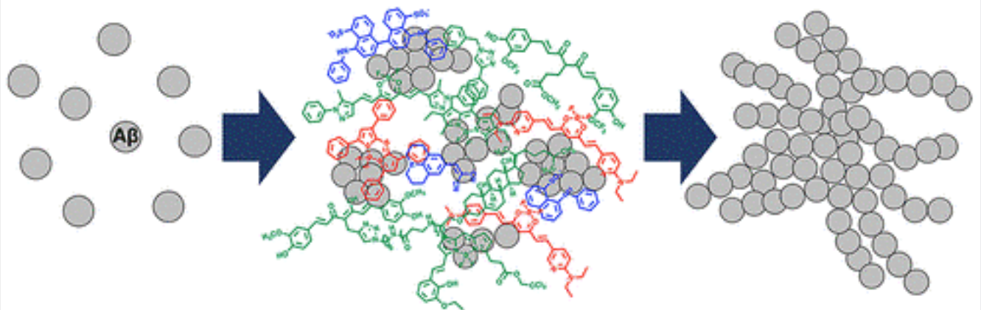
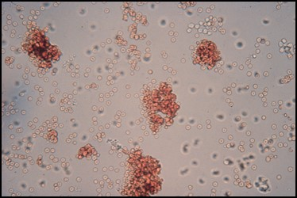
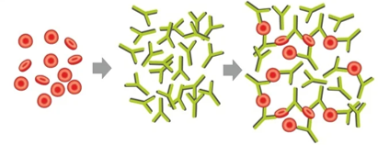
Background - Agglutination
Notes:
Let's first understand what agglutination is. It is a crucial biological phenomenon where particles such as cells or microorganisms clump together in the presence of specific antibodies or antigens. This process plays a vital role in immunology and medical diagnostics.

Slide 4
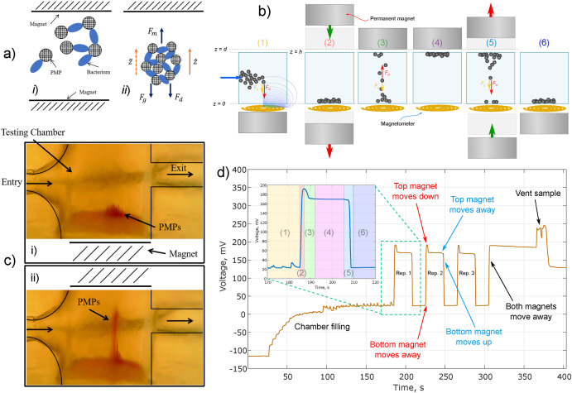
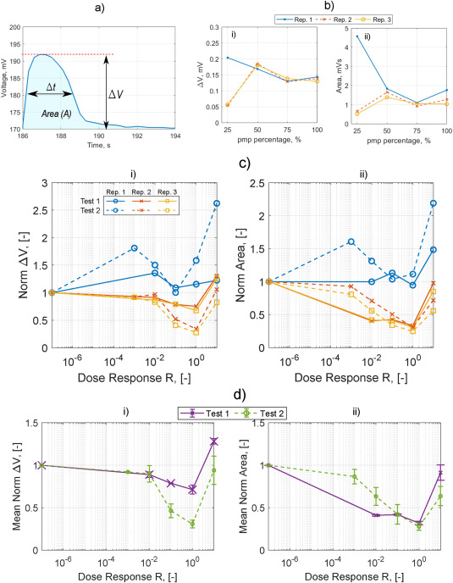
Background - Current Challenges
Traditional manual analysis
Time-consuming process
Subjective interpretation
Hughes R, Fishman A, Lamb-Riddell K, Sleigh Muñoz V, Champneys A, Kiely J, Luxton R. Modelling a dynamic magneto-agglutination bioassay. Biosens Bioelectron. 2023 Feb 15;222:114745. doi: 10.1016/j.bios.2022.114745. Epub 2022 Sep 28. PMID: 36502714.
Notes:
In reviewing the literature, I came across Robert and his team developed a novel magneto-immunoassay device that combines microfluidic magnetic bead actuation with agglutination principles for bacterial detection. The device measures the dynamic movement of paramagnetic particle (PMP) clusters through a fluid chamber using an inductive magnetometer, where the cluster size correlates with bacterial concentration. However, one of their key difficulties in designing new rapid Point-Of-Care immunoassays is the lack of quantitative understanding of the underlying physics, so that device development requires a trial and error approach.
And also Agglutination tests are widely used in various medical applications, including blood typing, detecting infections, and identifying specific pathogens, due to their speed, simplicity, and versatility.
While Traditional interpretation of agglutination patterns remains a complex challenge, relying heavily on experienced technicians performing manual analysis. This process is not only time-consuming but also susceptible to subjective judgment.

Slide 5

Question:
Can we develop an automated method for accurate recognition and quantification of agglutination patterns?
Notes:
So the question just naturally comes up that Can we develop an automated method for accurate recognition and quantification of agglutination patterns?
Specifically, we aimed to address several key challenges:
l Can we develop a real-time analysis system that would optimize measurement timing during experiments, rather than relying on post-processing of voltage signals for their model?
l How can we overcome the challenge of limited training data while maintaining model accuracy?
l Can we develop a system that matches or exceeds the accuracy of manual analysis while providing objective, reproducible results?

Slide 6
Background - Current Challenges
Traditional manual analysis
Time-consuming process
Subjective interpretation
Hughes R, Fishman A, Lamb-Riddell K, Sleigh Muñoz V, Champneys A, Kiely J, Luxton R. Modelling a dynamic magneto-agglutination bioassay. Biosens Bioelectron. 2023 Feb 15;222:114745. doi: 10.1016/j.bios.2022.114745. Epub 2022 Sep 28. PMID: 36502714.
Notes:
So our model aims to assist in interpreting the dose-response characteristics shown here. Specifically, looking at the Heidelberger curve effect they observed, our model can predict optimal detection ranges by identifying the most sensitive detection window between R from approximately ten to the minus second power to one, determining where signal changes are most significant, and helping predict when saturation occurs. Additionally, for sample preparation, our model can determine if samples need dilution to fall within the optimal detection range, predict agglutination levels before measurement, and help optimize initial sample concentration.

Slide 7
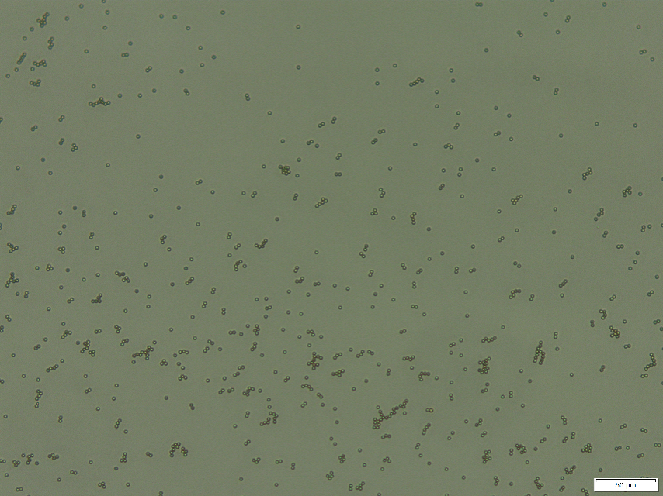
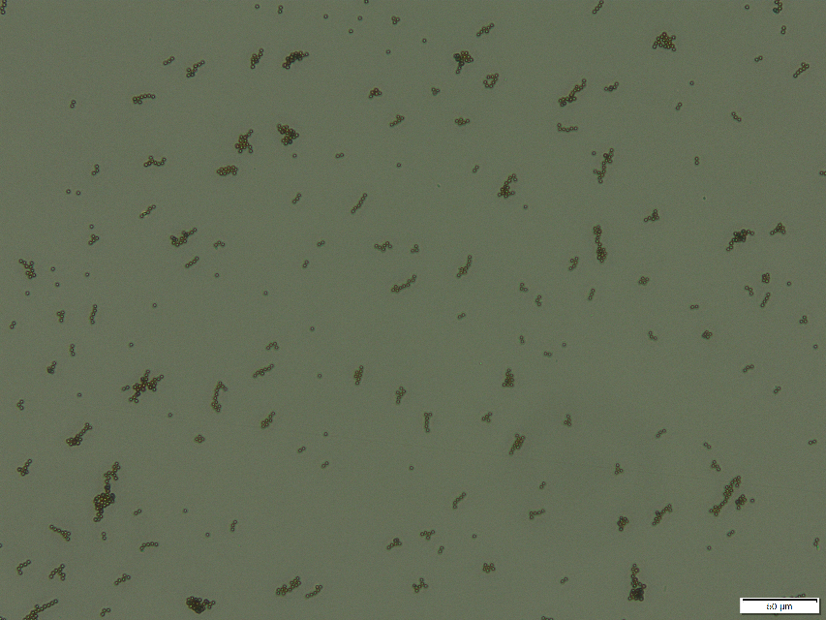
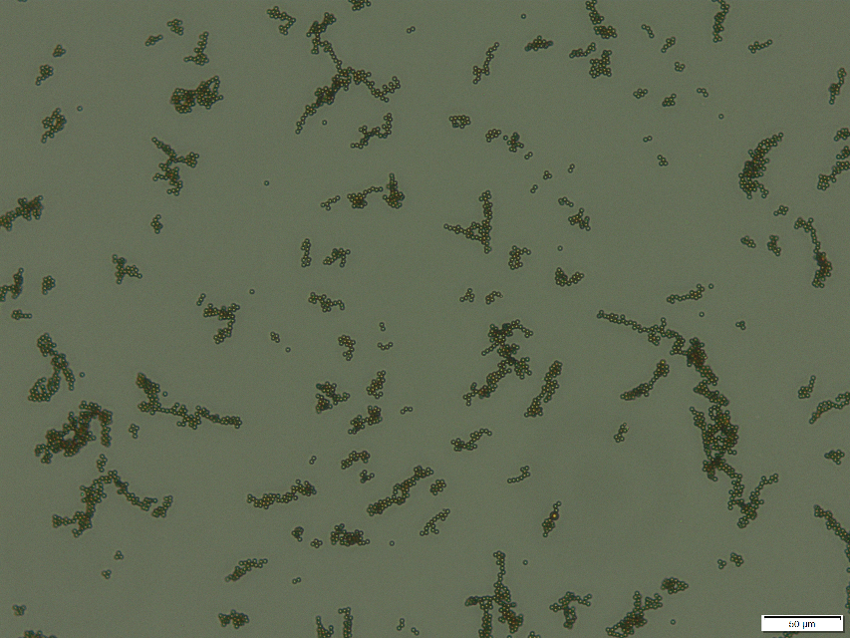
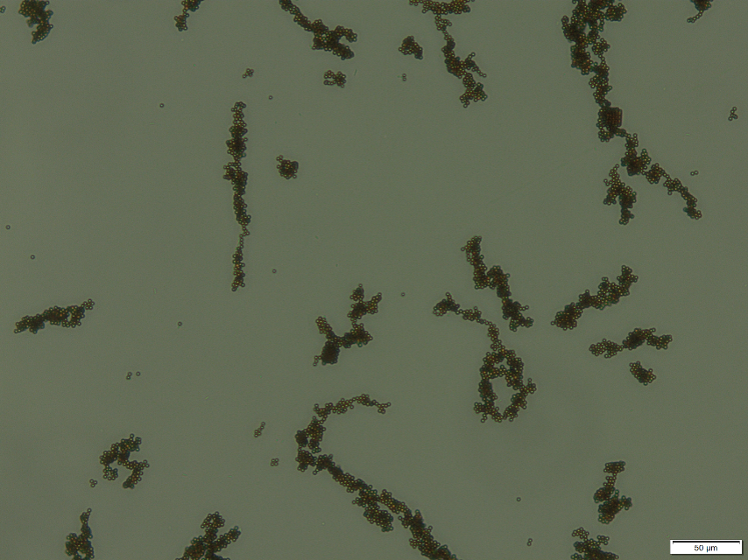
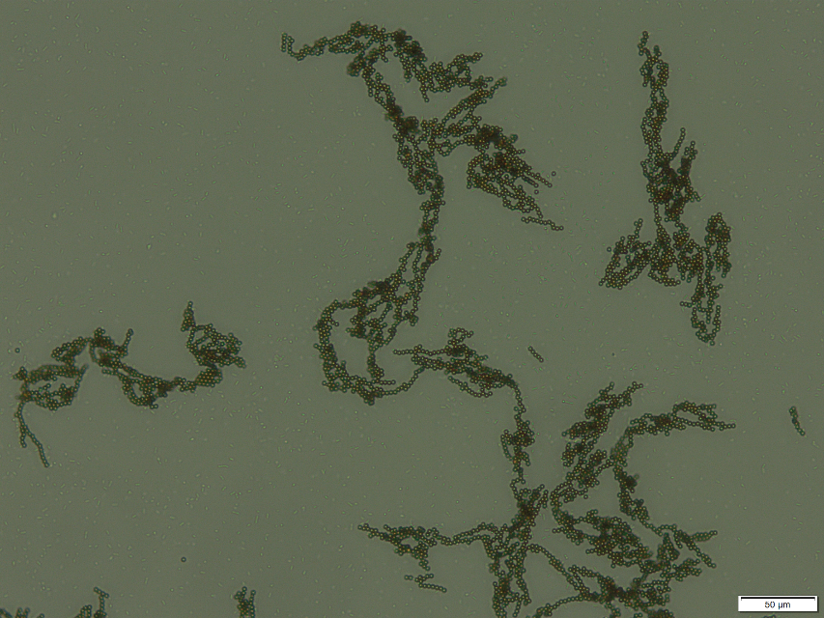
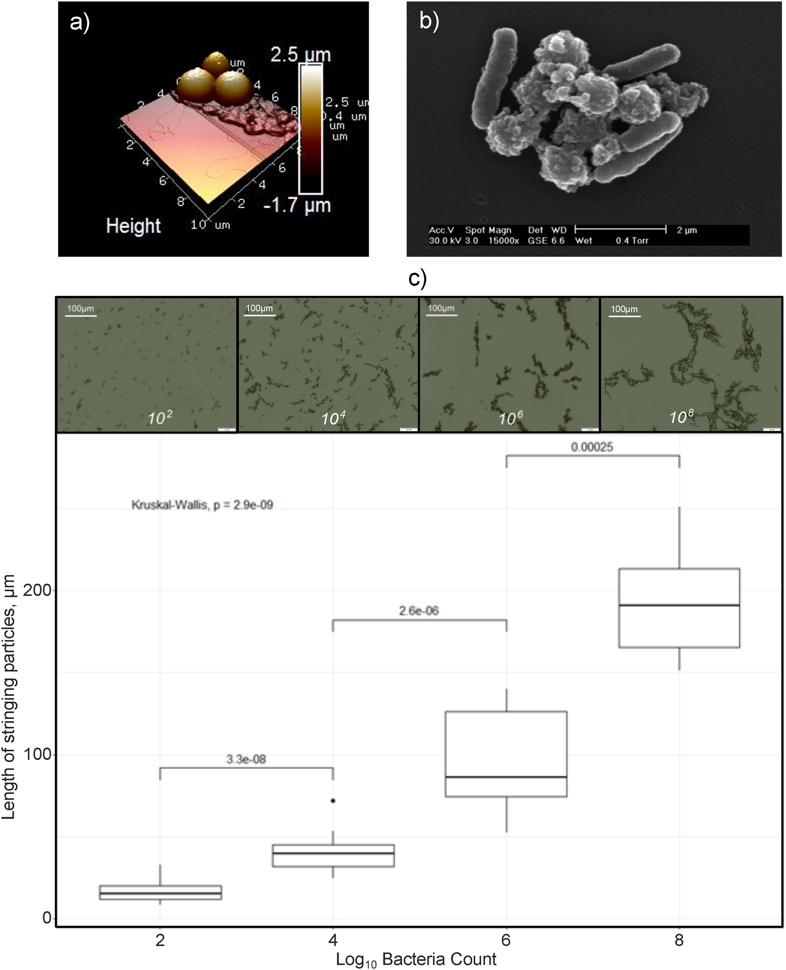
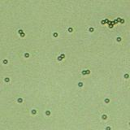
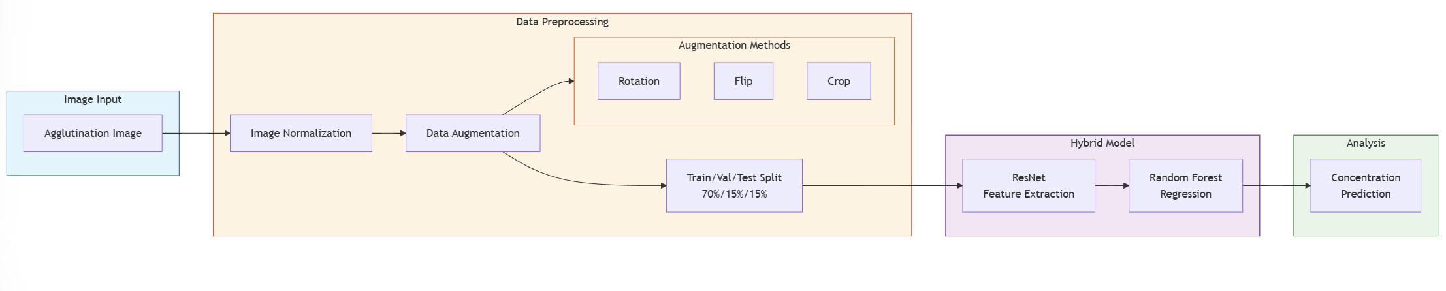
Methodology - Data
0
10²
10⁴
10⁶
10⁸
Notes:
To address these challenges, I developed an innovative hybrid model called the ResNet-RF model using Python, combining the strengths of Residual Network (ResNet) and Random Forest.
The experimental design followed a systematic approach. For data collection and processing, we implemented a standardized image preprocessing pipeline and split our data into training (70%), validation (15%), and test (15%) sets. In model parameter estimation, we utilized cross-validation for hyperparameter tuning, optimized ResNet parameters through transfer learning, and fine-tuned Random Forest parameters using grid search, focusing on key parameters including learning rate, number of trees, and feature extraction layers. Our data analysis framework evaluated the model using MSE and R² metrics, compared performance against baseline models, and analyzed error patterns and model limitations. For software implementation, we developed a user-friendly GUI with real-time image processing pipeline, integrated model inference system, and intuitive result visualization interface.

Slide 8
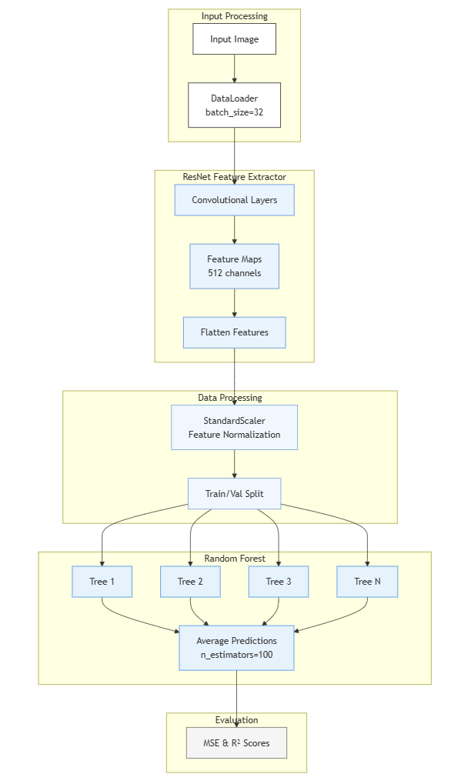
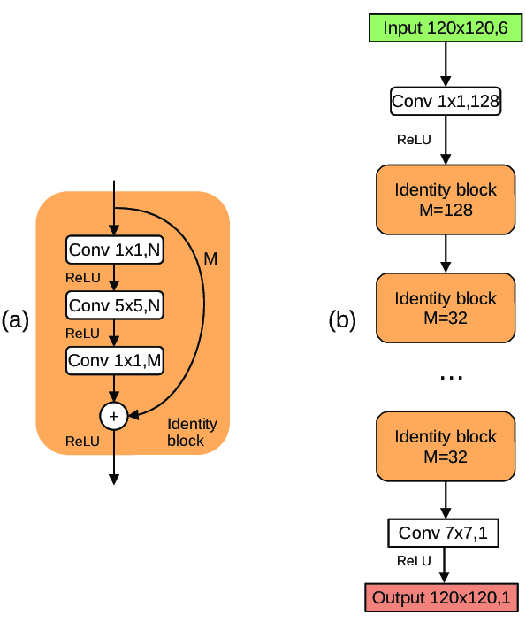
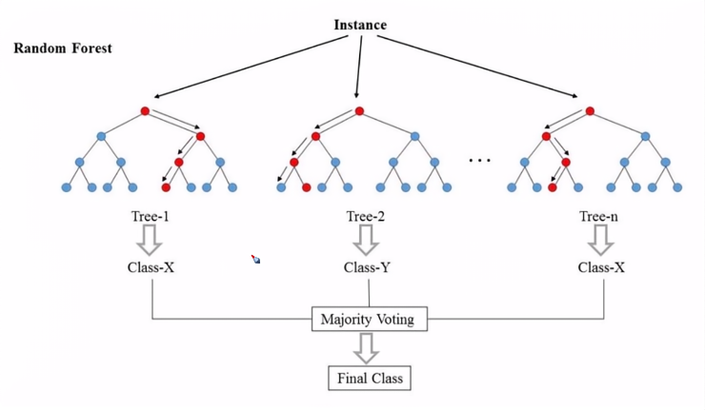
Methodology
Hybrid Model Architecture:ResNet-RF Model
Extract image feature
Robust to overfitting
Handles limited data well
Notes:
At the core of our hybrid approach, the ResNet component serves as our feature extractor. ResNet, or Residual Network, is a powerful deep learning architecture specifically designed for image processing. Its key innovation is the use of skip connections, which helps solve the vanishing gradient problem in deep networks. In our application, ResNet excels at extracting meaningful features from agglutination images.
Random Forest Component
Random Forest is an ensemble learning method that operates by constructing multiple decision trees and outputting the mean prediction of individual trees. Each tree is built using a random subset of training data and features, which helps prevent overfitting. In our model, Random Forest takes the features extracted by ResNet and performs the final prediction step.
During our model selection process, we conducted extensive experimentation and evaluation, comparing our ResNet-RF model against several other approaches:
· Linear Regression
· Support Vector Regression (SVR)
· Standard Random Forest
· Deep learning models (CNN, and ResNet)

Slide 9
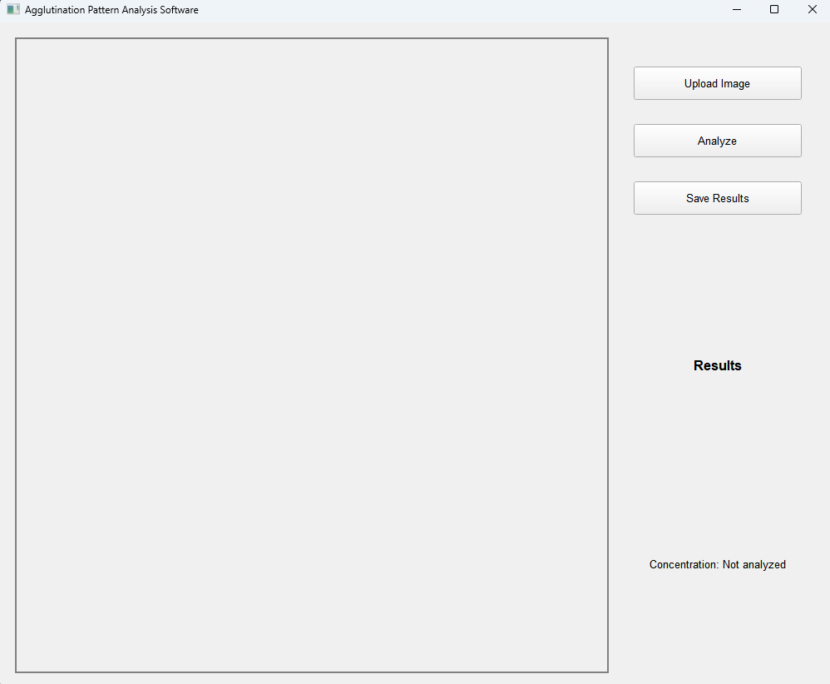
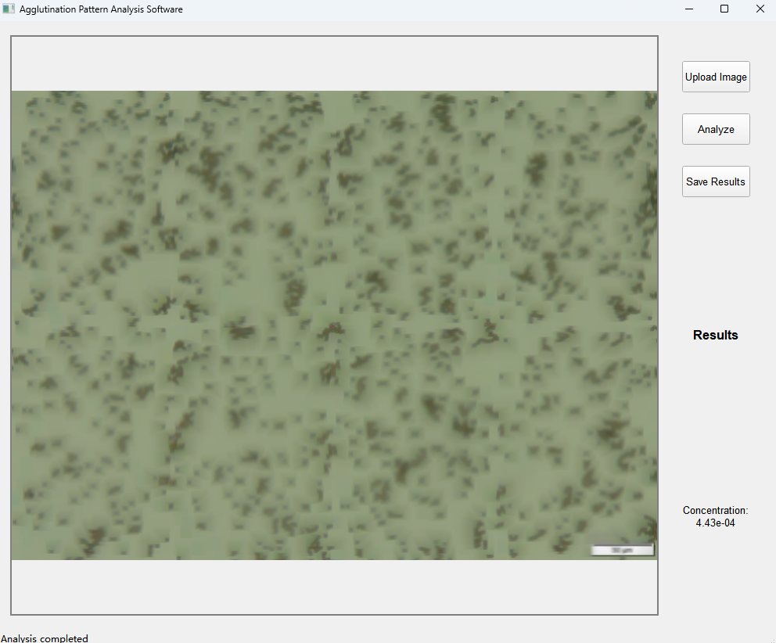
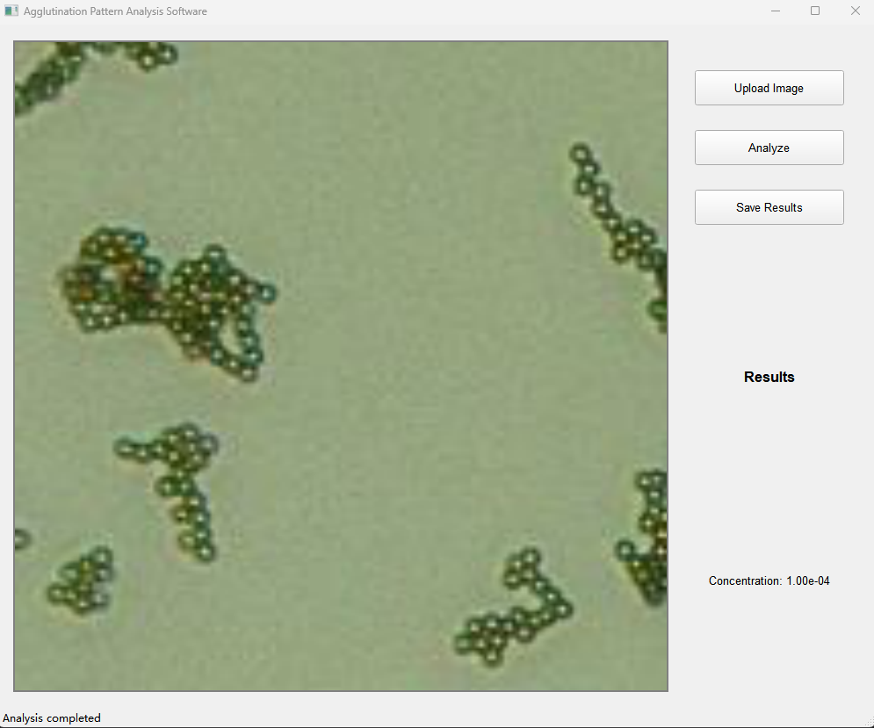
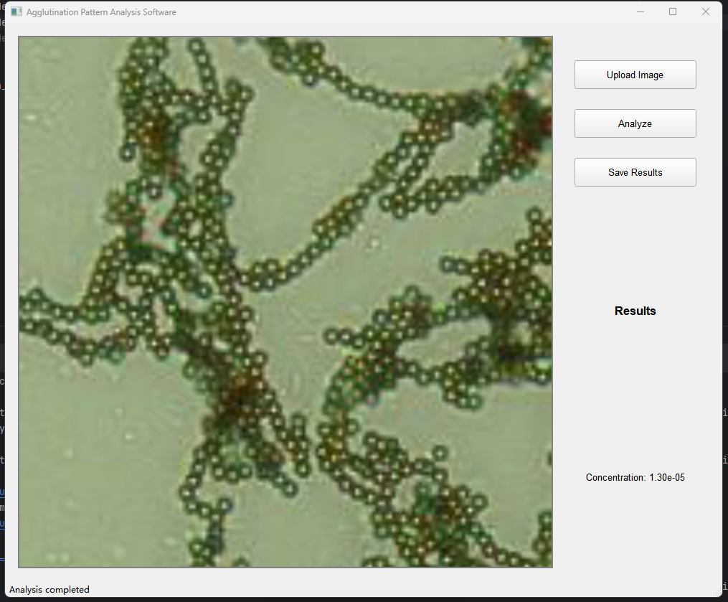
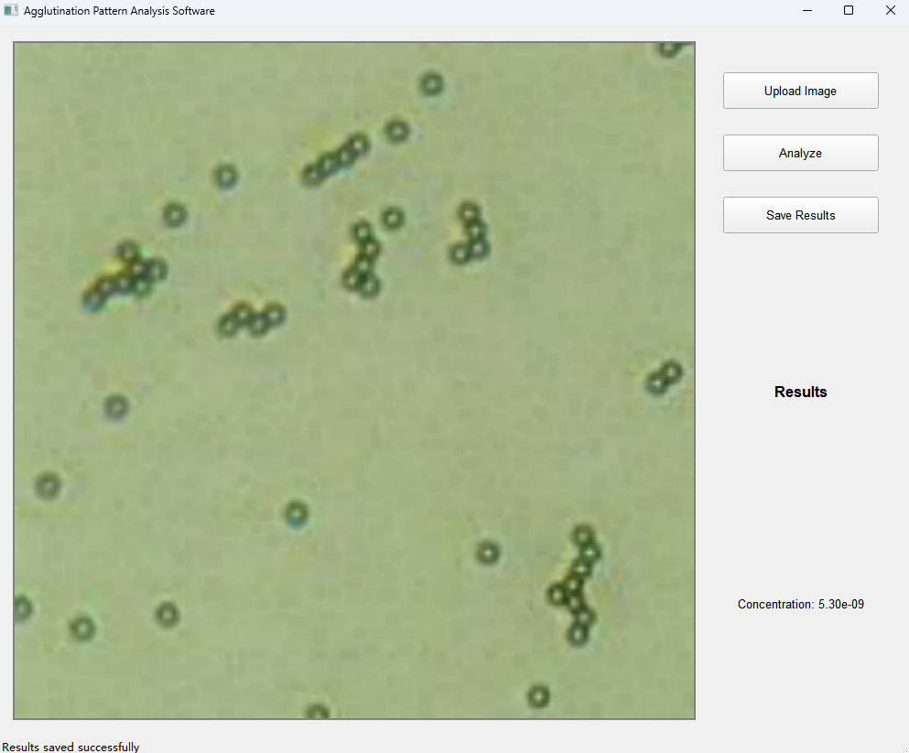
Results Demo - GUI Development
Notes:
To ensure practical applicability in lab settings and clinical settings, I developed a user-friendly Graphical User Interface (GUI) that simplifies image upload, analysis, and result interpretation.

Slide 10
Results
Superior agglutination pattern analysis
Successful detection across various concentrations
Effective with limited training data through augmentation
Notes:
Through extensive testing and validation, our ResNet-RF hybrid model demonstrated superior performance in analyzing agglutination patterns. The model showing robust performance across different concentration ranges, particularly in the critical detection window between R from approximately ten to the minus second power to one.
Compared to traditional manual analysis, our system not only improved accuracy but also significantly reduced analysis time and enhanced measurement reproducibility. This automated approach proves particularly valuable for Robert's magneto-immunoassay system, as it offers quantitative analysis capabilities and real-time concentration determination.
The system successfully detected agglutination patterns across various concentrations, maintaining accuracy even with limited training data through our data augmentation strategy. Moreover, our model's ability to identify optimal detection ranges and guide sample preparation addresses a key challenge in POC immunoassays - the lack of quantitative understanding of the underlying physics. This integration of machine learning with immunoassay techniques shows promise for advancing POC diagnostic systems, potentially enabling more rapid and accurate disease detection in clinical settings. The automated, quantitative analysis approach could significantly enhance the accessibility and reliability of diagnostic testing in both research and clinical applications.

Slide 11
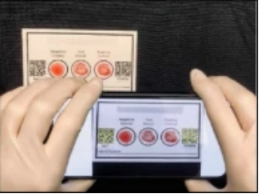
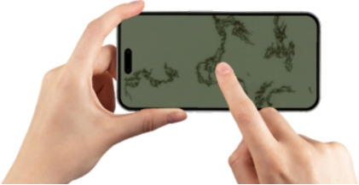
Challenges & Limitations
Dataset limitations
Pattern complexity
Integration challenges
More portable
Notes:
During our research, we encountered several significant challenges. The primary challenge was dataset acquisition - while we employed data augmentation techniques to expand our dataset through image processing, the fundamental dataset size remained limited. Although we received some SARS and ‘lepto’spirosis datasets, the significant differences in image characteristics made them incompatible with our model. Ideally, for broader clinical applications, our model should be trained on diverse datasets including blood samples and various pathogens beyond just E. coli.
The second major challenge lay in pattern recognition complexity. Agglutination patterns show considerable variation in their manifestation, making it difficult to establish consistent recognition parameters. Different concentrations can produce subtle variations in clustering patterns, requiring sophisticated feature extraction capabilities to distinguish effectively.
Finally, the integration of deep learning and traditional machine learning approaches presented unique challenges. Balancing the feature extraction capabilities of ResNet with the regression analysis of Random Forest required careful optimization to ensure both components worked harmoniously while maintaining model interpretability and performance.
These limitations suggest several directions for future research, particularly in expanding the diversity and size of training datasets to enhance the model's generalizability across different types of biological samples.

Slide 12
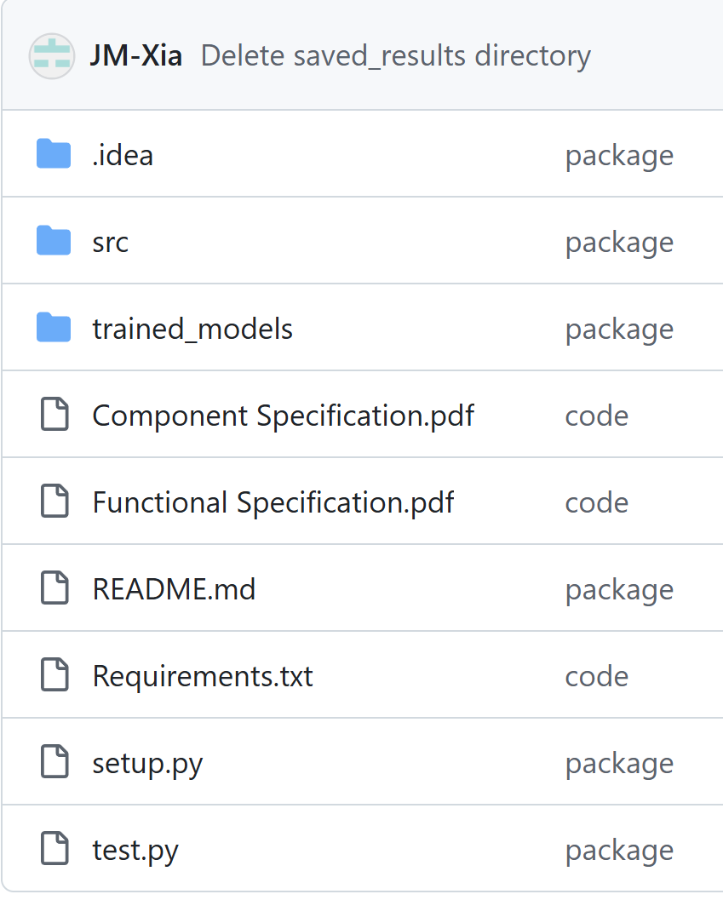
Repository
📦 AgglutinationConcentrationCaculator
┣ 📂 src
┃ ┗ 📂 AgglutinationConcentrationCaculator
┃ ┣ 📜 init.py
┃ ┣ 📜 main.py
┃ ┣ 📜 utils.py
┃ ┣ 📂 models
┃ ┣ 📂 models
┃ ┗ 📂 GUI
┃ ┣ 📜 init.py
┃ ┣ 📜 main_window.py
┃ ┗ 📂 components
┃ ┣ 📜 init.py
┃ ┗ 📜 image_viewer.py
┣ 📜 test.py
┣ 📜 setup.py
┣ 📜 requirements.txt
┣ 📜 README.md
┗ 📜 LICENSE
Main structure
Notes:
During our research, we encountered several significant challenges. The primary challenge was dataset acquisition - while we employed data augmentation techniques to expand our dataset through image processing, the fundamental dataset size remained limited. Although we received some SARS and ‘lepto’spirosis datasets, the significant differences in image characteristics made them incompatible with our model. Ideally, for broader clinical applications, our model should be trained on diverse datasets including blood samples and various pathogens beyond just E. coli.
The second major challenge lay in pattern recognition complexity. Agglutination patterns show considerable variation in their manifestation, making it difficult to establish consistent recognition parameters. Different concentrations can produce subtle variations in clustering patterns, requiring sophisticated feature extraction capabilities to distinguish effectively.
Finally, the integration of deep learning and traditional machine learning approaches presented unique challenges. Balancing the feature extraction capabilities of ResNet with the regression analysis of Random Forest required careful optimization to ensure both components worked harmoniously while maintaining model interpretability and performance.
These limitations suggest several directions for future research, particularly in expanding the diversity and size of training datasets to enhance the model's generalizability across different types of biological samples.

Slide 13
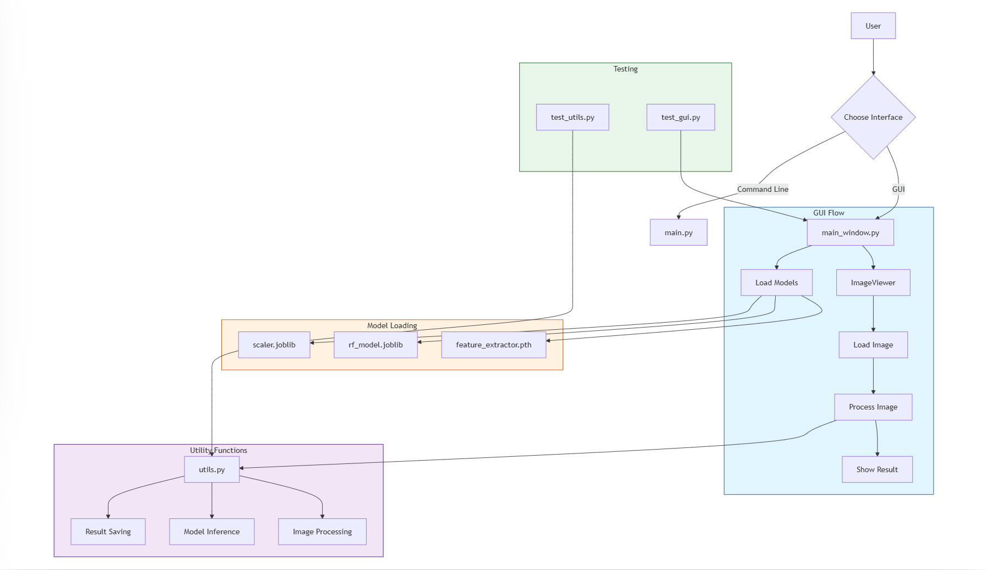
Repository
Notes:
During our research, we encountered several significant challenges. The primary challenge was dataset acquisition - while we employed data augmentation techniques to expand our dataset through image processing, the fundamental dataset size remained limited. Although we received some SARS and ‘lepto’spirosis datasets, the significant differences in image characteristics made them incompatible with our model. Ideally, for broader clinical applications, our model should be trained on diverse datasets including blood samples and various pathogens beyond just E. coli.
The second major challenge lay in pattern recognition complexity. Agglutination patterns show considerable variation in their manifestation, making it difficult to establish consistent recognition parameters. Different concentrations can produce subtle variations in clustering patterns, requiring sophisticated feature extraction capabilities to distinguish effectively.
Finally, the integration of deep learning and traditional machine learning approaches presented unique challenges. Balancing the feature extraction capabilities of ResNet with the regression analysis of Random Forest required careful optimization to ensure both components worked harmoniously while maintaining model interpretability and performance.
These limitations suggest several directions for future research, particularly in expanding the diversity and size of training datasets to enhance the model's generalizability across different types of biological samples.

Slide 14
Thank
you!!

